Slide 1


INNOVATIVE ENHANCEMENT IN ONLINE DELIVERY SERVICE
24-25J-298
1
12/5/24
Notes:
1

Slide 2
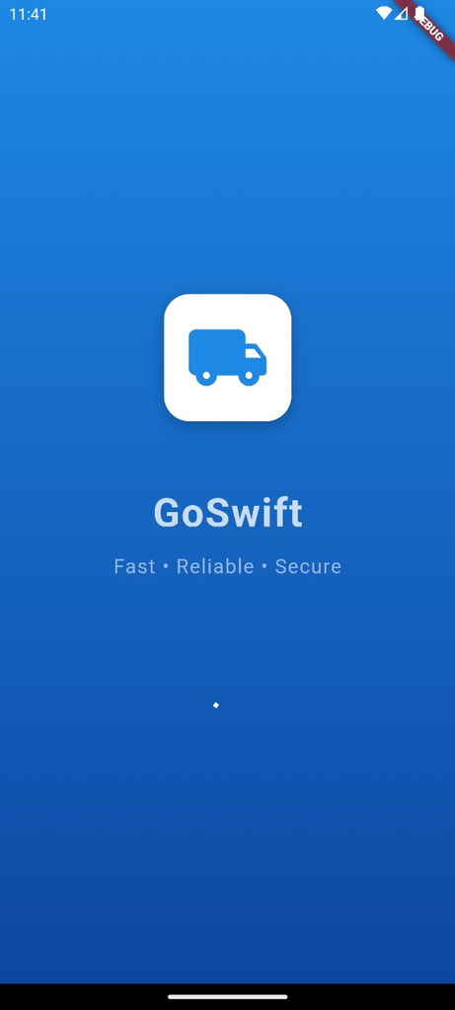
GoSwift
Fast - Reliable - Secure
2

Slide 3








Our Team
Mr. Uditha Dharmakeerthi
Mr. Amila Senarathne
Supervisor
Co-Supervisor
Rathnayaka K.P.Y.N
Ellewela A.V.H
Dissanayake D.T.D
Silva K.H.L.D
3
12/5/24

Slide 4

Content
Introduction
Research Question
Objectives
System Overview Diagram
Technologies
Individual Components Section
Commercialization Aspects
4
12/5/24

Slide 5

1. INTRODUCTION
The rising demand for reliable delivery services highlights the need for efficient logistics.
Unreliable delivery, poor routing, and tracking issues cause customer dissatisfaction.
AI and ML streamline processes, boost accuracy, and cut costs.
Better communication and feedback improve the customer experience.
Optimize delivery with voice automation, fleet management, and CSAT analysis.
5
12/5/24
Notes:
4

Slide 6

2. RESEARCH QUESTION
How can the integration of advanced technologies, such as AI, Machine Learning, and automated systems, enhance the efficiency and effectiveness of the item delivery process in eCommerce?
6
12/5/24

Slide 7

3. OBJECTIVES
Sub Objectives
Main Objective
To Implement an automated voice activation system for the courier service to enhance delivery time prediction.
To recognize the employee behavior and identify the improvements as a percentage.
To implement a fleet management system with path optimization and delivery time prediction.
To analyze customer satisfaction (CAST) regarding the item delivery through voice-based feedback.
To Implement a system to increase the effectiveness and efficiency in item delivery process
7
12/5/24
‹#›
Notes:
6

Slide 8

04
SYSTEM
OVERVIEW
8
12/5/24

Slide 9
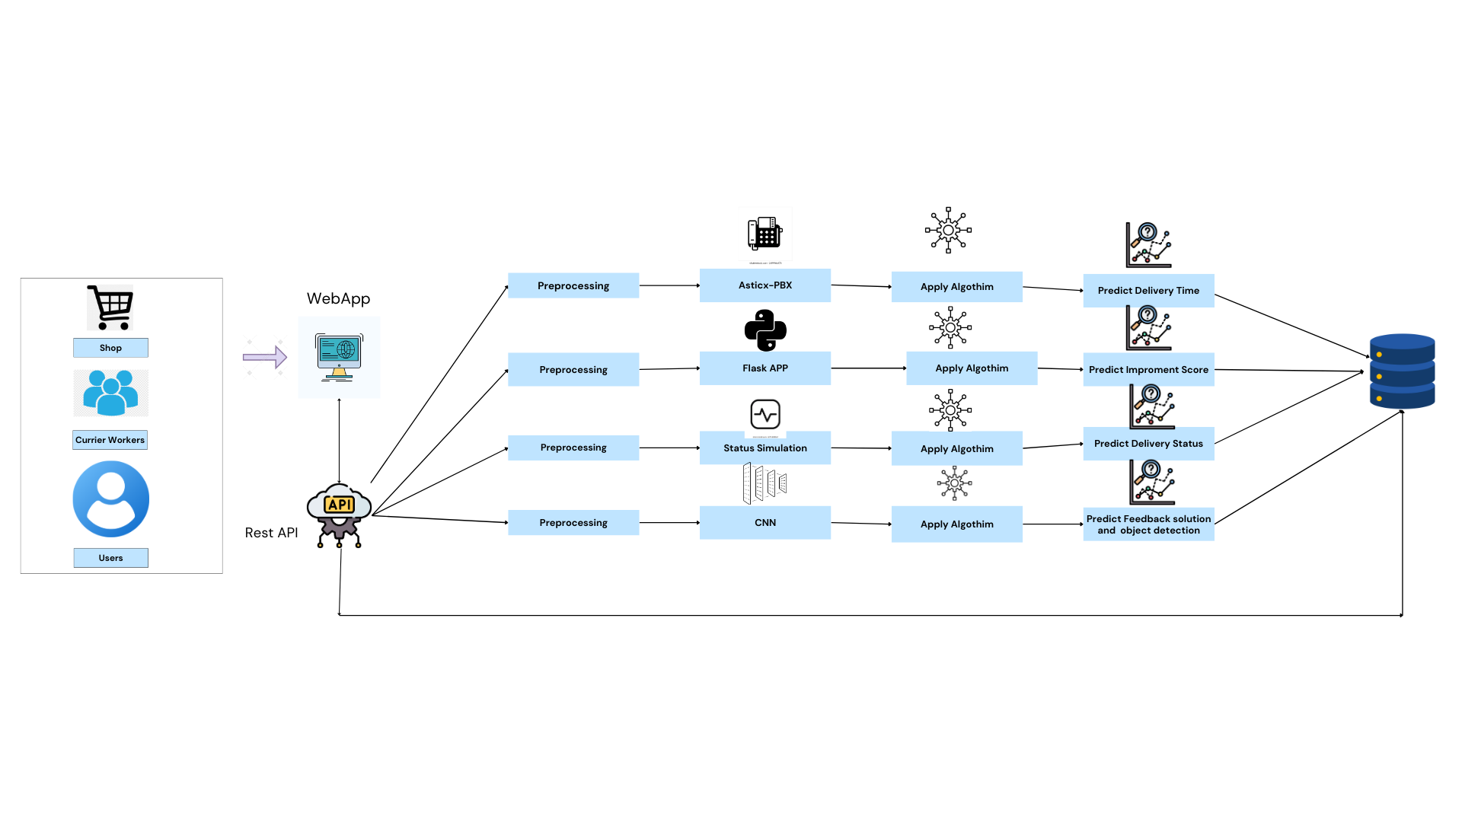

Mobile App
9
12/5/24

Slide 10





05
TECHNOLOGIES
10
12/5/24
Notes:
9

Slide 11
06
INDIVIDUAL
COMPONENTS
11
12/5/24

Slide 12
Student Must add a professional photo to this cage
IT21361272 | Ellewela A.V.H
BSc (Hons) Degree in Information Technology (specialization in Information Technology )
11
12/5/24
Notes:
11

Slide 13


COMPONENT 01
Implement an automated voice activation system for the courier service to enhance delivery schedule prediction.
IT21361272 | Ellewela A.V.H | 24-25J-298
12/5/24
‹#›
Notes:
12

Slide 14
BACKGROUND
Customers expect accurate, real-time delivery updates in today's eCommerce landscape.
Manual tracking and updates lead to delays and inaccurate delivery time predictions.
. Voice automation boosts delivery accuracy and satisfaction.
RESEARCH GAP
The research gap is in the incomplete coverage of delivery time estimation research, particularly in automated system confirmation, call generation, and delivery schedule identification. This calls for further research on integrated models and systems for accurate delivery schedule estimation.
IT21361272 | Ellewela A.V.H | 24-25J-298
12/5/24
‹#›

Slide 15

RESEARCH PROBLEM
Manual tracking causes delays and inaccurate delivery predictions in courier services, leading to customer dissatisfaction. An automated voice activation system can improve real-time updates and accuracy, addressing this issue?
IT21361272 | Ellewela A.V.H | 24-25J-298
12/5/24
‹#›
Notes:
14

Slide 16
SPECIFIC OBJECTIVES
To implement an automated voice activation system that improves delivery schedule prediction by providing real-time updates, enhancing communication between couriers and customers, and ensuring accurate and timely delivery information.
IT21361272 | Ellewela A.V.H | 24-25J-298
12/5/24
‹#›

Slide 17
SUB OBJECTIVES
To Create a voice-activated system that allows users to interact with courier services to receive and manage delivery schedule predictions seamlessly.
To Enhance real-time communication between couriers and customers through voice-based updates, improving delivery accuracy and customer satisfaction.
IT21361272 | Ellewela A.V.H | 24-25J-298
12/5/24
‹#›

Slide 18
METHODOLOGY
IT21361272 | Ellewela A.V.H | 24-25J-298
‹#›
12/5/24
‹#›
Notes:
17

Slide 19
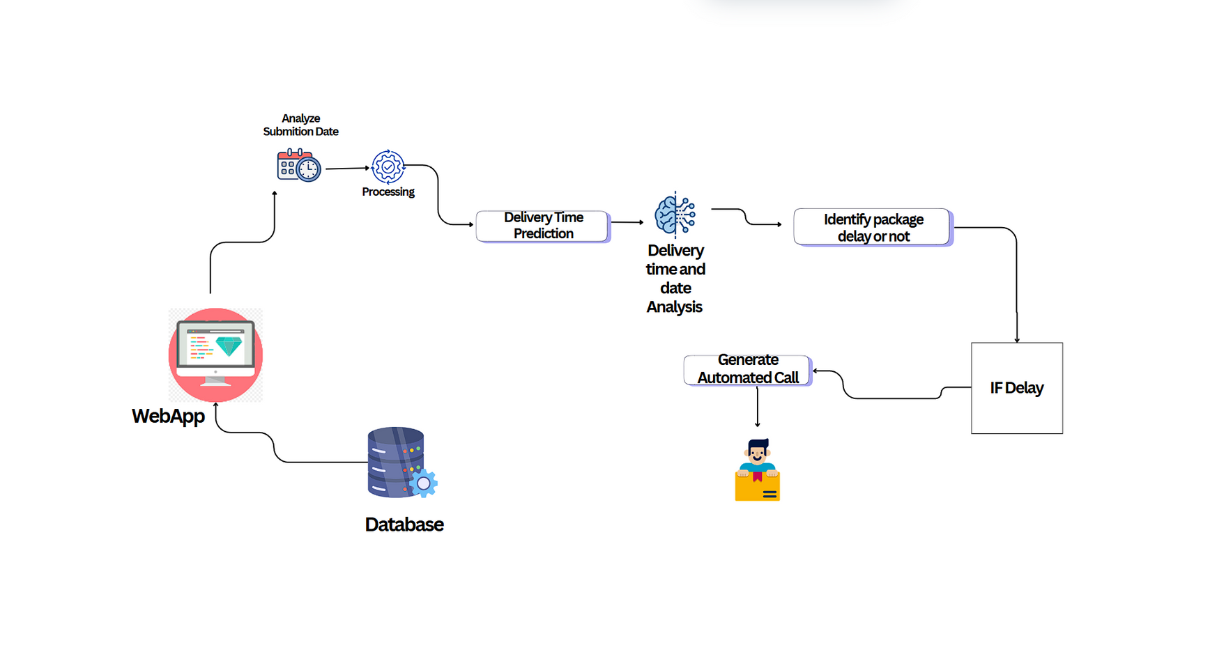
COMPONENT DIAGRAM
IT21361272 | Ellewela A.V.H | 24-25J-298
‹#›
12/5/24
‹#›

Slide 20

COMPLETION & FUTURE WORKS
Completion of the component
Delivery Data Collection
Implemented delivery delay estimation
Completed training and fine-tuning models for delivery time schedule
Integrate models into an automated voice activation system
Develop and implement real-time update system
Integrate Backend and Frontend
IT21361272 | Ellewela A.V.H | 24-25J-298
‹#›
12/5/24
‹#›

Slide 21
DEMONSTRATION
Completed training and fine-tuning models for delivery time predication
IT21361272 | Ellewela A.V.H | 24-25J-298
‹#›
12/5/24
‹#›

Slide 22
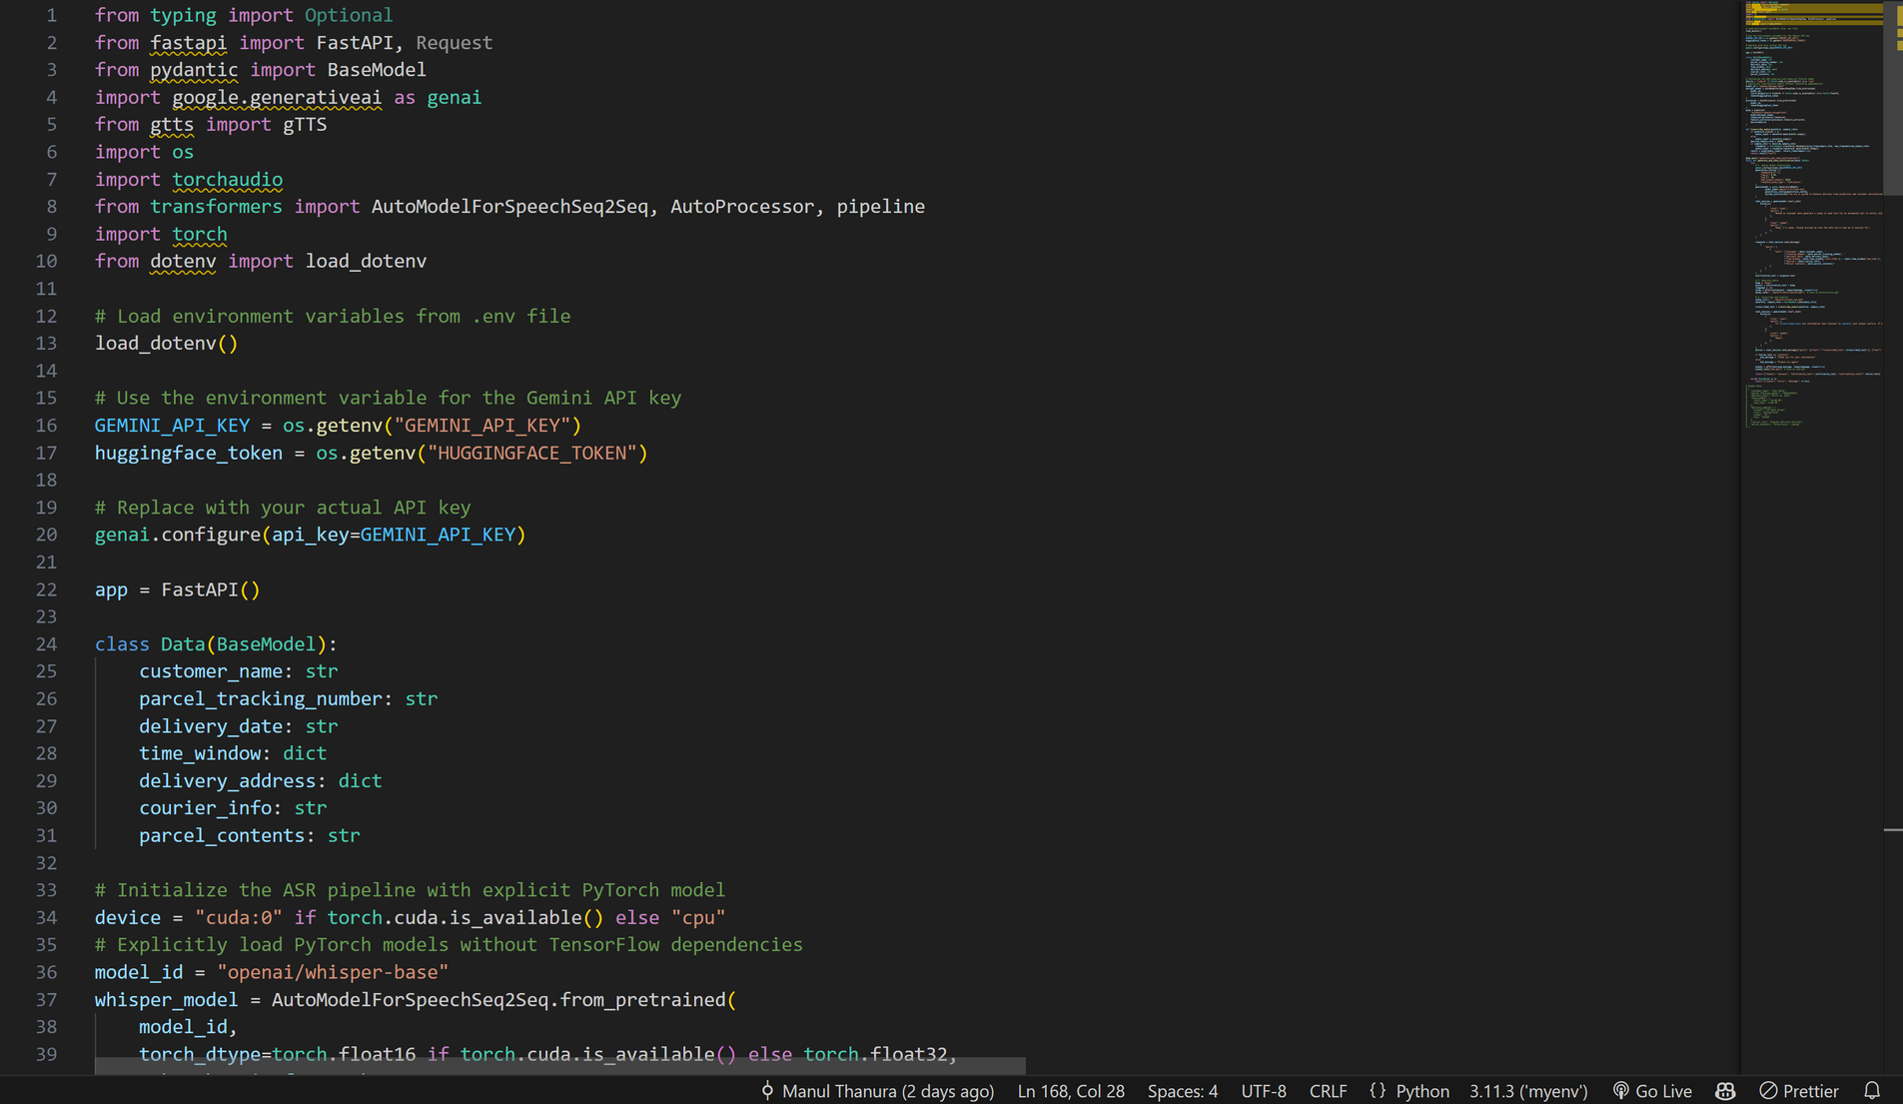
Python Code Data Processing
Voice to text genaration part
IT21361272 | Ellewela A.V.H | 24-25J-298
‹#›
12/5/24
‹#›

Slide 23
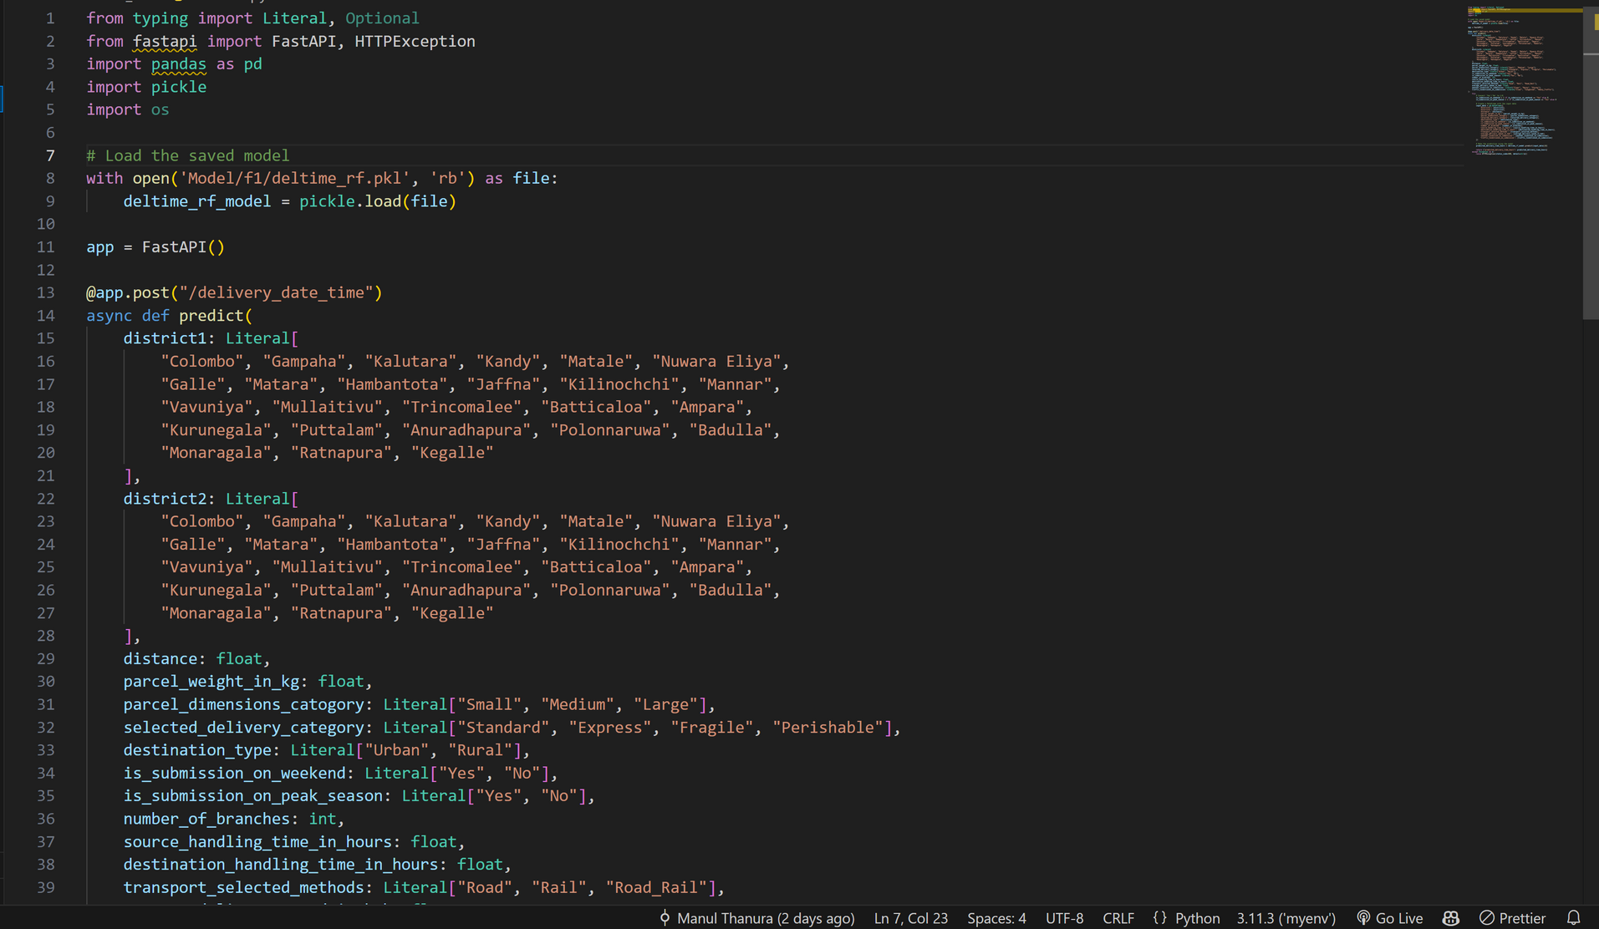
Delivery Time Prediction Part
IT21361272 | Ellewela A.V.H | 24-25J-298
‹#›
12/5/24
‹#›

Slide 24
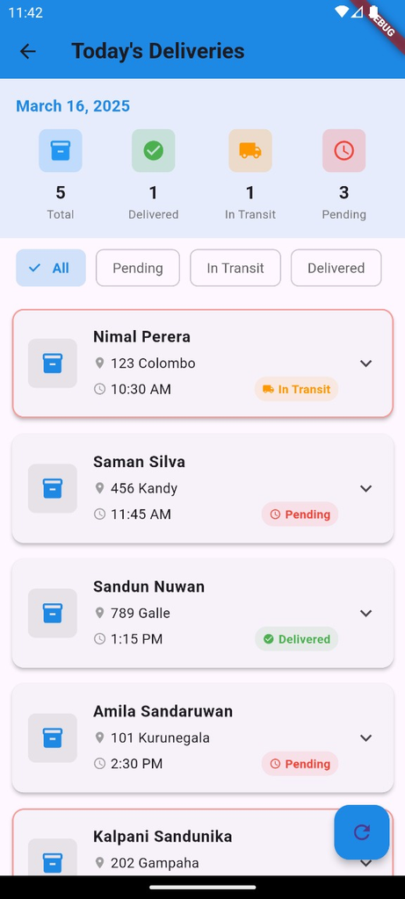
GoSwift Delivery Dashboard
IT21361272 | Ellewela A.V.H | 24-25J-298
‹#›
12/5/24
‹#›

Slide 25
TECHNOLIGIES USED
Delivery schedule prediction: Schedulee prediction model, fine-tuned with dataset .
qwwwwqPrediction: Random Forest Regressor.
Voice To Text Convert: Whisper Model.
Automated Voice Activation System: Twilio
IT21361272 | Ellewela A.V.H | 24-25J-298
‹#›
12/5/24
‹#›

Slide 26
COMPONENT SPECIFIC REQUIREMENTS
Functional
Non Functional
Voice Command Processing
Delivery schedule Prediction
Proactive Delay Notifications
Real-Time Data Updates
Customer Query Resolution
Performance
Usability
Scalability
Security
Reliability
IT21361272 | Ellewela A.V.H | 24-25J-298
‹#›
12/5/24
‹#›

Slide 27
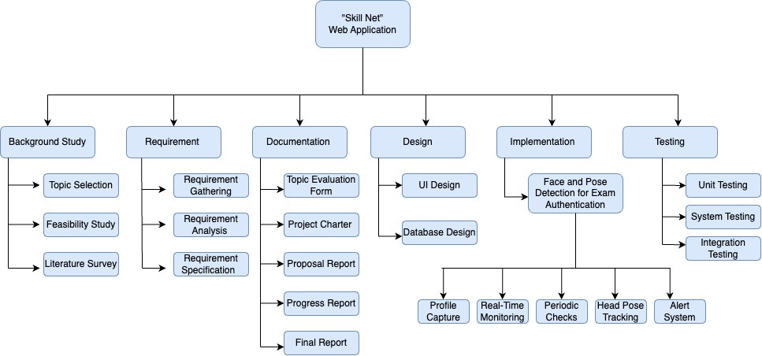
WORK BREAKDOWN CHART
IT21361272 | Ellewela A.V.H | 24-25J-298
‹#›
12/5/24
‹#›

Slide 28
REFERENCES
[1] Employee Recognition, Task Performance, and OCB: Mediated and Moderated by Pride(https://www.mdpi.com/2071-1050/14/3/1631 )
[2] The Key Strategies for Measuring Employee Performance in Companies: A Systematic Review(https://www.researchgate.net/publication/367528681 )
[3] Role of Work Breaks in Well-Being and Performance(https://www.researchgate.net/publication/361913348_ )
[4] Putting the System Into Performance Management Systems: A Review and Agenda for Performance Management Research(https://www.researchgate.net/publication/323040479_ )
[5] Employee Recognition and Performance:A Field Experiment(https://people.duke.edu/~dandan/webfiles/PapersPayoff/Scarcity_02June2015.pd )
IT21361272 | Ellewela A.V.H | 24-25J-298
‹#›
12/5/24
‹#›

Slide 29

Student Must add a professional photo to this cage
BSc (Hons) Degree in Information Technology (specialization in Information Technology )
IT21031748 | Rathnayaka K.P.Y.N
12/5/24
‹#›
Notes:
29

Slide 30

COMPONENT 02
Recognized the employee behaviour and identify the improvements as a percentage.
IT21031748 | Rathnayaka K.P.Y.N | 24-25J-298
‹#›
12/5/24
‹#›
Notes:
30

Slide 31
BACKGROUND
Track key metrics such as attendance, delivery times, task completion, amployee behaviour across various time frames (peak hours, holidays, etc.) to identify patterns and workload distribution.
Evaluate the need for additional staffing during peak times or reduced staffing during off-peak periods using historical data
RESEARCH GAP
The research gap highlights a lack of comprehensive systems integrating employee performance tracking, workload analysis, coverage optimization during peak times, and forecasted scheduling tools, which existing studies address only partially.
IT21031748 | Rathnayaka K.P.Y.N | 24-25J-298
‹#›
12/5/24
‹#›

Slide 32

RESEARCH PROBLEM
Machine learning enhances workforce management by predicting staffing needs, optimizing employee performance, and improving delivery times through behavior analysis, key performance metrics, and predictive staffing solutions. ?
IT21031748 | Rathnayaka K.P.Y.N | 24-25J-298
‹#›
12/5/24
‹#›

Slide 33
SPECIFIC OBJECTIVE
To develop a machine learning-based system that predicts future staffing needs and enhances employee performance by analysing behaviour patterns, thereby improving operational efficiency and resource allocation.
SUB OBJECTIVES
Data Collection: Collect and organize attendance records, task completion rates, and work schedules..
Behaviour Analysis : Analyze employee behavior during peak hours, holidays, and regular times to assess workload distribution.
Machine Learning Implementation: Implement machine learning to predict staffing needs and optimize workforce efficiency.
Performance Forecasting: Provide forecasts to enhance staffing schedules and support workforce planning.platform
IT21031748 | Rathnayaka K.P.Y.N | 24-25J-298
‹#›
12/5/24
‹#›

Slide 34
METHODOLOGY
The methodology involves collecting key performance metrics (attendance, delivery times, task completion, customer feedback) through digital tools. Behavioral patterns are analyzed using statistical methods or machine learning to track performance improvements. Historical data is used to predict peak times and optimize staffing. The insights are integrated into a real-time system to provide continuous feedback and recommendations for improving employee performance.
IT21031748 | Rathnayaka K.P.Y.N | 24-25J-298
‹#›
12/5/24
‹#›

Slide 35
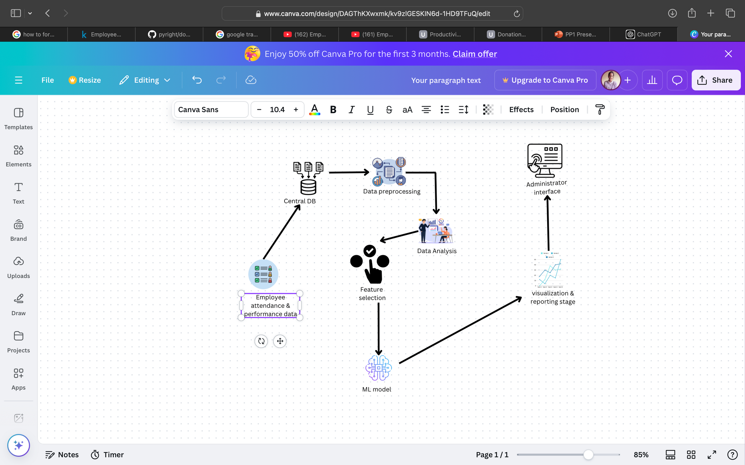
COMPONENT DIAGRAM
IT21031748 | Rathnayaka K.P.Y.N | 24-25J-298
‹#›
12/5/24
‹#›

Slide 36
COMPLETION AND FUTURE WORKS
Completion of the component
Collect data manually and create data set
Behavioural Analysis and staff Optimization
System Integration
Enhanced machine learning models
Real time data processing
Future works of the component
Enhanced machine learning models
Integrate Backend and Frontend
Enhanced machine learning models
IT21031748 | Rathnayaka K.P.Y.N | 24-25J-298
‹#›
12/5/24
‹#›

Slide 37
DEMONSTRATION
Completed training and fine-tuning models for delivery time predication
IT21361272 | Ellewela A.V.H | 24-25J-298
‹#›
12/5/24
‹#›

Slide 38
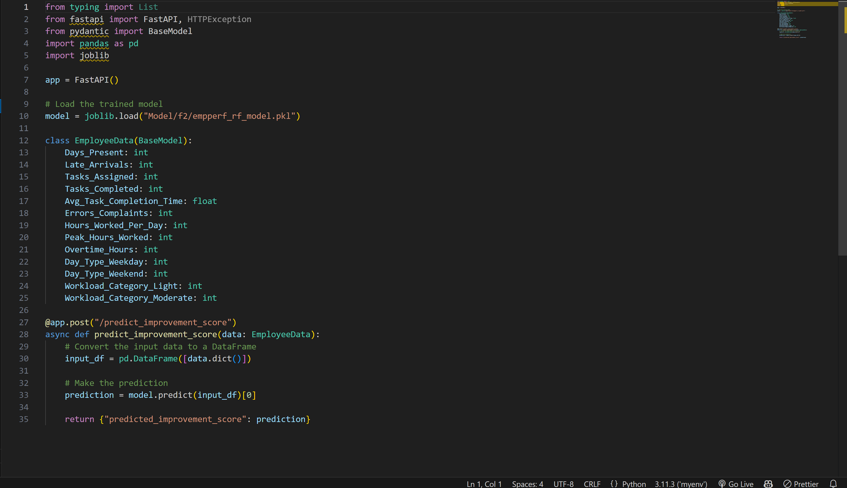
Python Code Data Processing
Improment Score Model
IT21031748 | Rathnayaka K.P.Y.N | 24-25J-298
‹#›
12/5/24
‹#›

Slide 39
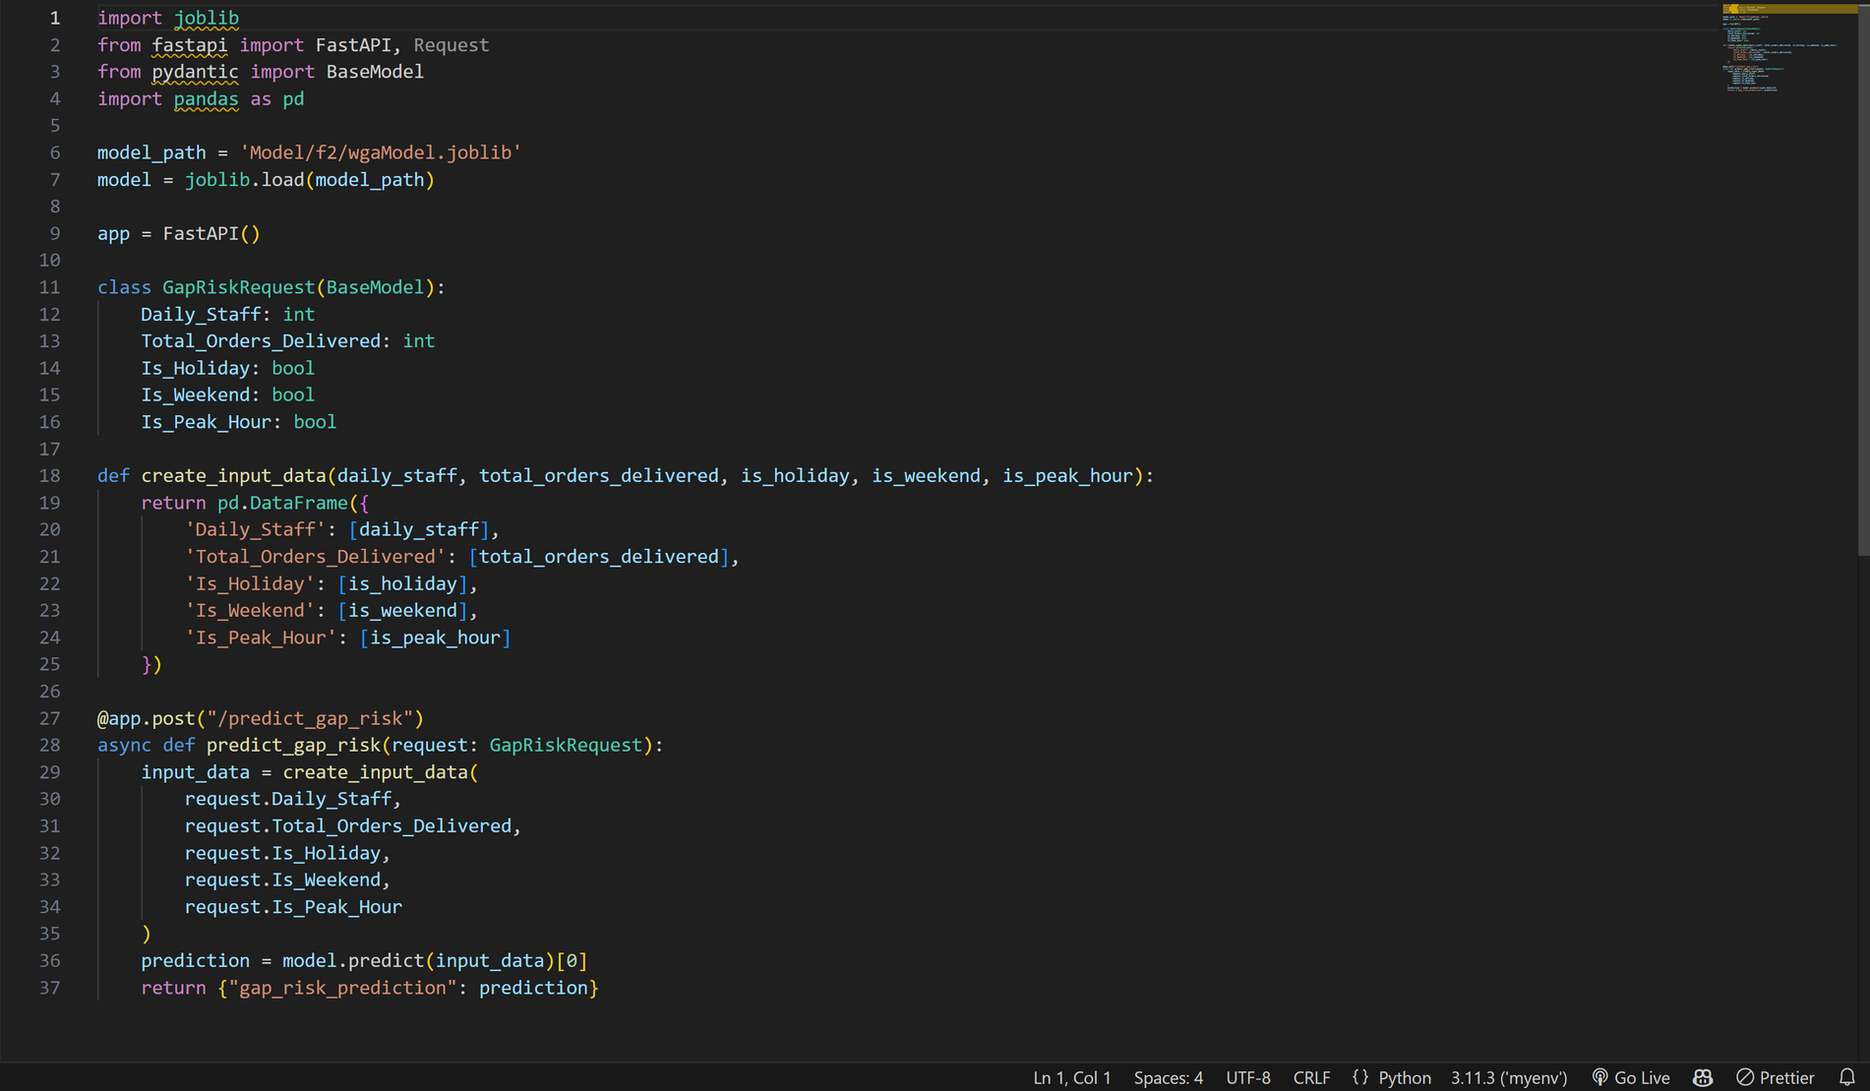
Gap Risk Prediction Model
IT21031748 | Rathnayaka K.P.Y.N | 24-25J-298
‹#›
12/5/24
‹#›

Slide 40
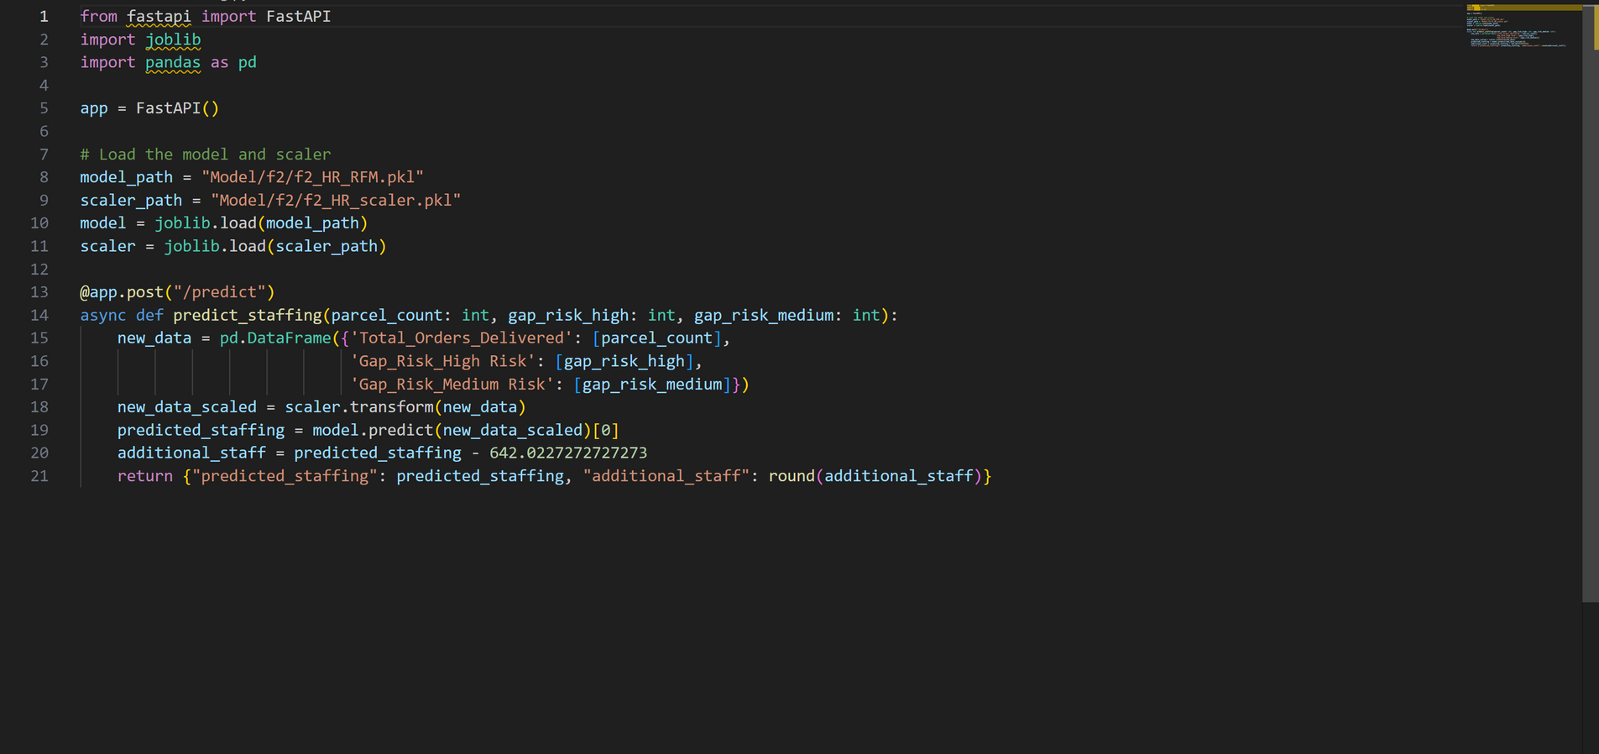
Staff Prediction Model
IT21031748 | Rathnayaka K.P.Y.N | 24-25J-298
099
‹#›
12/5/24
‹#›

Slide 41
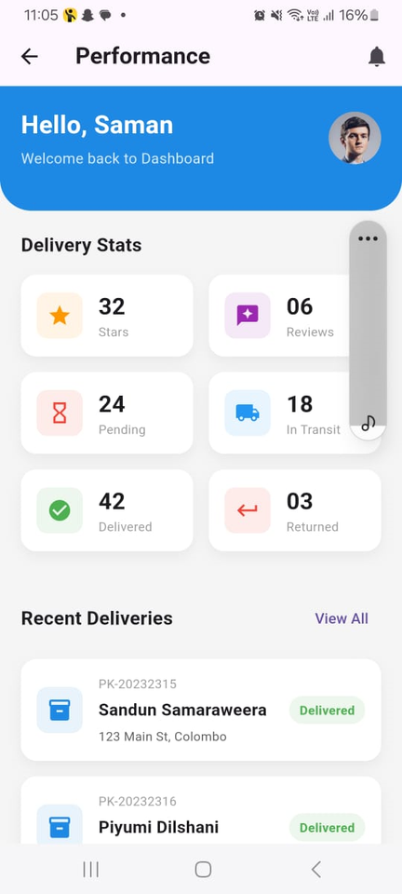
GoSwift Employee Performence Dashboard
IT21031748 | Rathnayaka K.P.Y.N | 24-25J-298
‹#›
12/5/24
‹#›

Slide 42
COMPONENT SPECIFIC REQUIREMENTS
Functional Requirements
Non-Functional Requirements
Data collection
Behavioral Pattern Analysis:
Improvement Calculation:
Staffing Recommendations:
Reliability
Availability
Maintainability
Security
IT21031748 | Rathnayaka K.P.Y.N | 24-25J-298
‹#›
12/5/24
‹#›

Slide 43
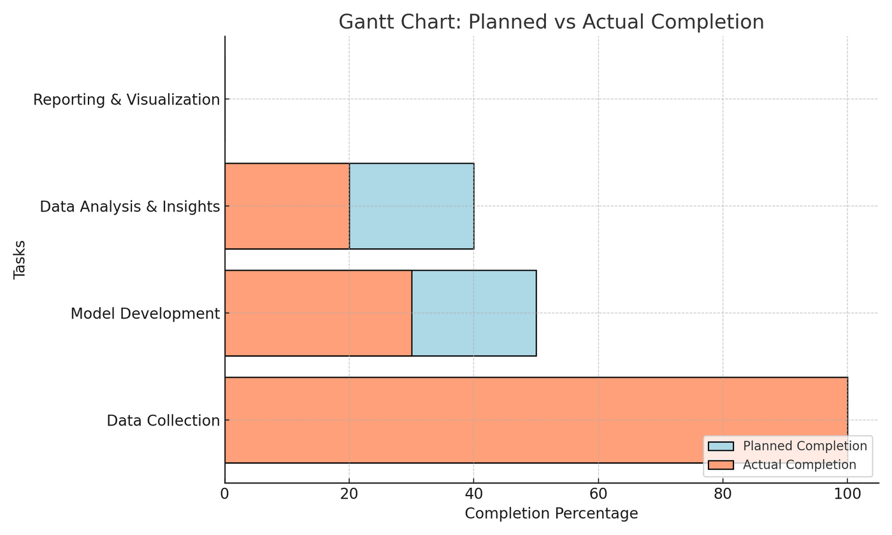
WORK BREAKDOWN CHART
IT21031748 | Rathnayaka K.P.Y.N | 24-25J-298
‹#›
12/5/24
‹#›

Slide 44
REFERENCES
[1] Employee Recognition, Task Performance, and OCB: Mediated and Moderated by Pride(https://www.mdpi.com/2071-1050/14/3/1631 )
[2] The Key Strategies for Measuring Employee Performance in Companies: A Systematic Review(https://www.researchgate.net/publication/367528681 )
[3] Role of Work Breaks in Well-Being and Performance(https://www.researchgate.net/publication/361913348_ )
[4] Putting the System Into Performance Management Systems: A Review and Agenda for Performance Management Research(https://www.researchgate.net/publication/323040479_ )
[5] Employee Recognition and Performance:A Field Experiment(https://people.duke.edu/~dandan/webfiles/PapersPayoff/Scarcity_02June2015.pd )
IT21031748 | Rathnayaka K.P.Y.N | 24-25J-298
‹#›
12/5/24
‹#›

Slide 45

IT21165948 | DISSANAYAKE D.T.D
BSc (Hons) Degree in Information Technology (specialization in Information Technology )
12/5/24
‹#›
Notes:
44

Slide 46

COMPONENT 03
Implement a fleet management system with delivery path optimization and weather,time prediction
IT21165948 | D.T.D Dissanayake | 24-25J-298
12/5/24
‹#›
Notes:
45

Slide 47
BACKGROUND
Challenges in Delivery services.
Improvement of predictive system logistics.
RESEARCH GAP
Current logistics systems use basic models that don’t integrate real-time factors like traffic, weather, and package details for accurate delivery predictions.
Lack adaptive machine learning techniques, leading to inefficient decisions and no real-time delivery status prediction with the time prediction.
This research develops an ML model to predict delivery status (yes/no) based on real-time and historical data, enhancing decision-making and efficiency and the time prediction.
IT21165948 | D.T.D Dissanayake | 24-25J-298
12/5/24
‹#›

Slide 48

RESEARCH PROBLEM
How can real-time factors like traffic, weather, and package details improve the accuracy of delivery predictions?
What machine learning techniques can be implemented to dynamically predict delivery status and optimize logistics decisions?
How predict time according to the delivery status?
IT21165948 | D.T.D Dissanayake | 24-25J-298
12/5/24
‹#›

Slide 49




OBJECTIVE
Sub objectives
To develop a machine learning model that predicts the delivery status (Yes or No) and estimated delivery time based on real-time data, optimizing logistics decisions and improving delivery efficiency.
Create a model to Check delivery status wheather the package is ok to delivery.
Predict the time
Find the best path to deliver(Route Optimization)
IT21165948 | D.T.D Dissanayake | 24-25J-298
‹#›
12/5/24
‹#›
Notes:
48

Slide 50
METHODOLOGY
IT21165948 | D.T.D Dissanayake | 24-25J-298
‹#›
12/5/24
‹#›

Slide 51
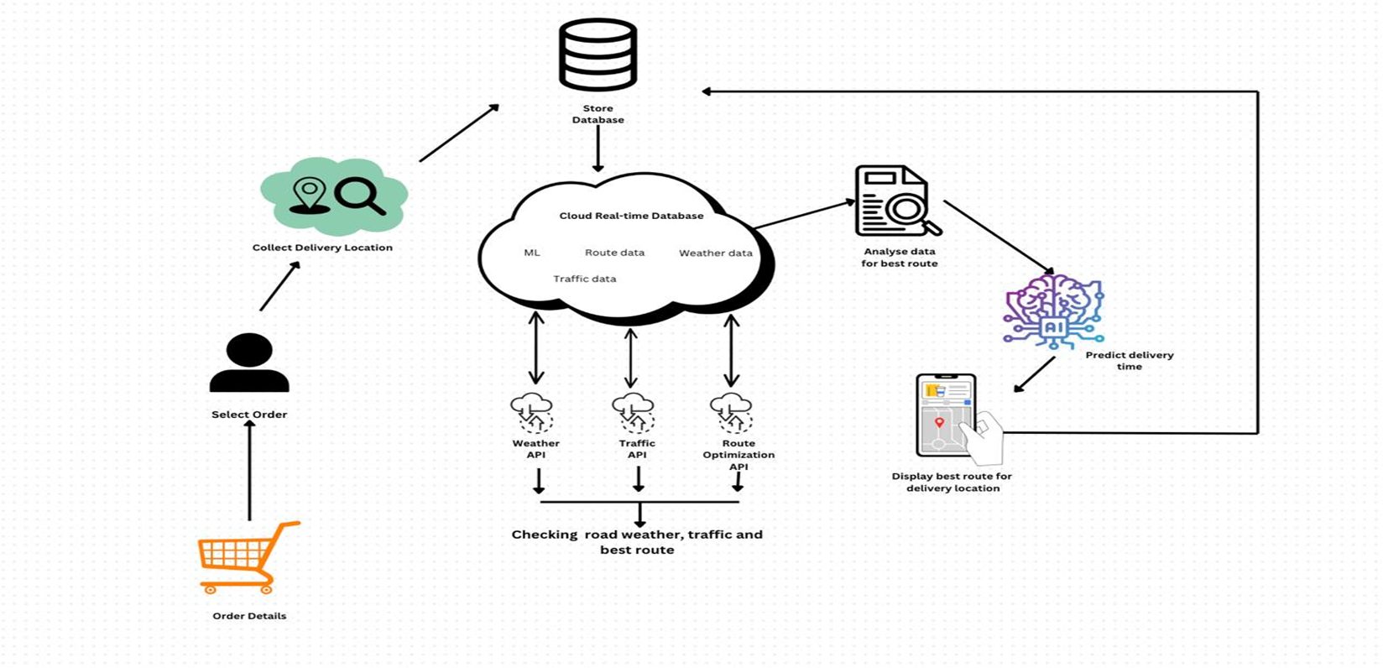
COMPONENT DIAGRAM
IT21165948 | D.T.D Dissanayake | 24-25J-298
‹#›
12/5/24
‹#›

Slide 52

COMPLETION & FUTURE WORKS
Data Preprocessing
Fine-tune model for Delivery status prediction
Integrate Backend and Frontend
Integrate the system components
IT21165948 | D.T.D Dissanayake | 24-25J-298
‹#›
12/5/24
‹#›

Slide 53

TOOLS AND TECHNOLIGIES
Delivery status Model Training Framework: KNeighborsClassifier
Data Standardization Tools:SVC,Logistic regression
Delivery time prediction model framework: Random Forest
Data Standardization Tools:Decision tree regression
IT21165948 | D.T.D Dissanayake | 24-25J-298
‹#›
12/5/24
‹#›

Slide 54
DEMONSTRATION
IT21165948 | D.T.D Dissanayake | 24-25J-298
‹#›
12/5/24
‹#›

Slide 55
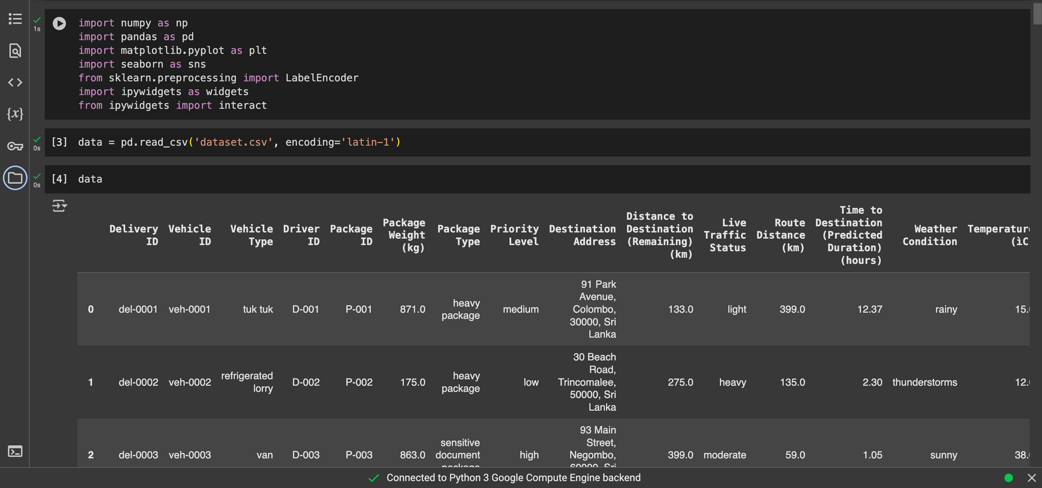
Python Code Data Processing
Delivery Status model
IT21165948 | D.T.D Dissanayake | 24-25J-298
‹#›
12/5/24
‹#›

Slide 56
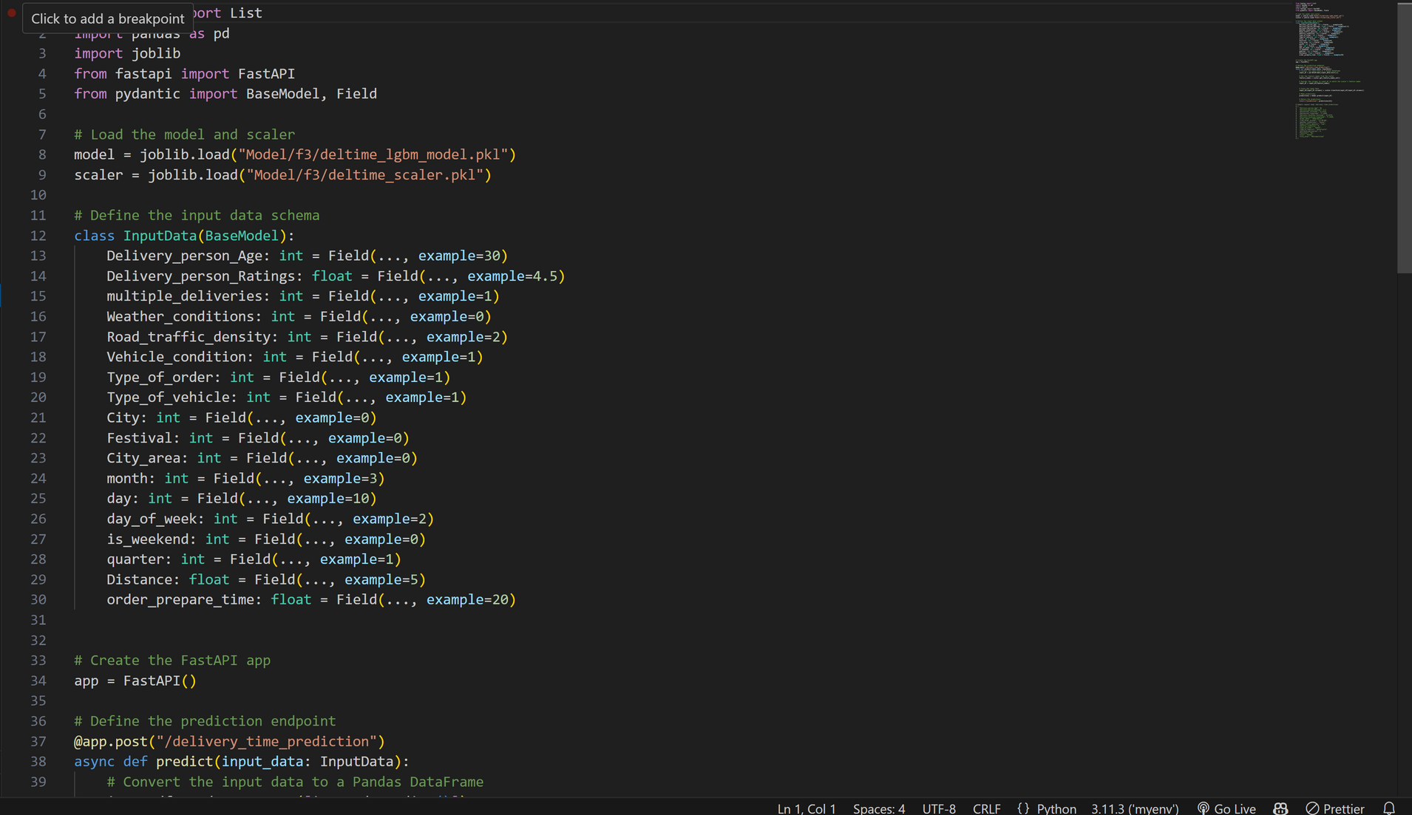
Delivery Time Prediction model
IT21165948 | D.T.D Dissanayake | 24-25J-298
‹#›
12/5/24
‹#›

Slide 57
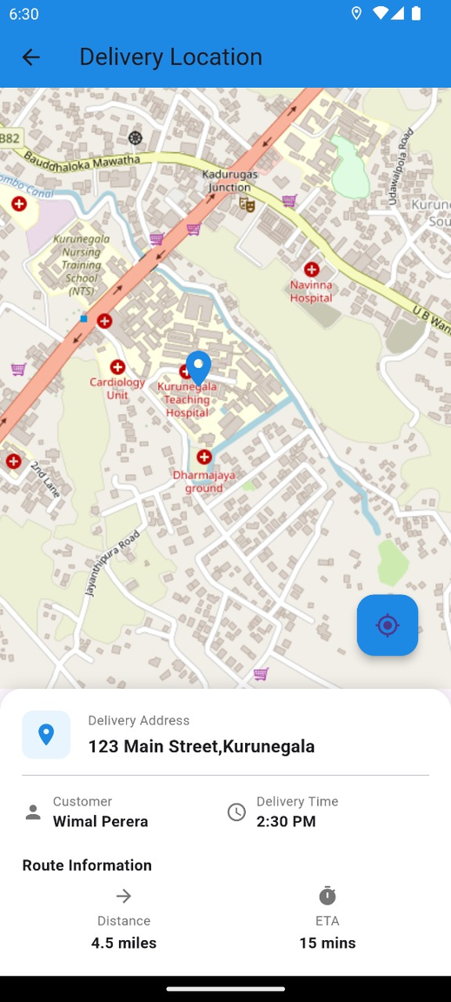
GoSwift Route Optimization
IT21165948 | D.T.D Dissanayake | 24-25J-298
‹#›
12/5/24
‹#›

Slide 58
COMPONENT SPECIFIC REQUIREMENTS
Functional Requirements
Non Functional Requirements
Reliable
speed
Accuracy
Data inputs
Accuracy Calculation
Result Display
Prediction and model training
IT21165948 | D.T.D Dissanayake | 24-25J-298
‹#›
12/5/24
‹#›

Slide 59
REFERENCES
[1] A Real-time Vehicle Routing Model for a Courier Service Problem
(https://www.researchgate.net/publication/227281341_ )
[2] Research on Optimization of Vehicle Routing Problem for Ride-sharing Taxi
(https://www.sciencedirect.com/science/article/pii/S1877042812010038)
[3] Case study on delivery time determination using a machine learning approach in small batch production
(https://link.springer.com/article/10.1007/s10845-023-02290-2)
[4] Boosting Algorithms for Delivery Time Prediction in Transportation Logistics
(https://ieeexplore.ieee.org/document/9346325)
IT21165948 | D.T.D Dissanayake | 24-25J-298
‹#›
12/5/24
‹#›

Slide 60
Student Must add a professional photo to this cage
IT21374838 | SILVA K.H.L.D
BSc (Hons) Degree in Information Technology (specialization in Information Technology )
12/5/24
‹#›
Notes:
58

Slide 61
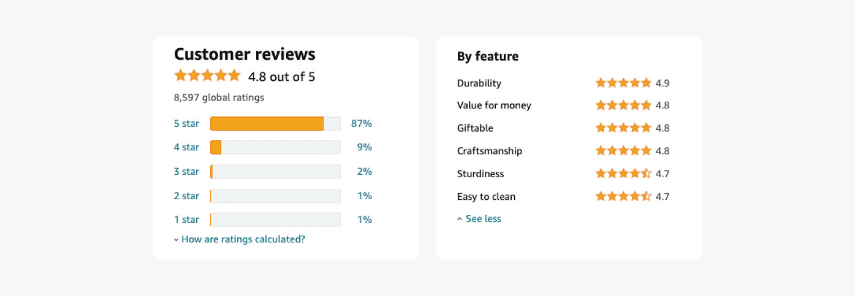
COMPONENT 04
Analyzing Customer Satisfaction (CSAT) Through Voice-based Feedback & Validity Checking
IT21374838 | Silva K.H.L.D | 24-25J-298
‹#›
12/5/24
‹#›
Notes:
59

Slide 62
BACKGROUND
Traditional methods of customer feedback collection, like surveys, are limited in real-time analysis and engagement.
Voice-based feedback offers a more interactive way for customers to express their opinions, leading to richer data.
Best use of AI and NLP
RESEARCH GAP
Integrating AI, ML, NLP, and image validation in logistics enhances customer feedback by combining voice analysis with visual proof. This unified system reduces fraud, improves issue validation, and boosts customer satisfaction while optimizing resources.
IT21374838 | Silva K.H.L.D | 24-25J-298
‹#›
12/5/24
‹#›

Slide 63

RESEARCH PROBLEM
How can AI-based object detection and voice feedback systems enhance performance in Delivery Services?
IT21374838 | Silva K.H.L.D | 24-25J-298
‹#›
12/5/24
‹#›

Slide 64

SPECIFIC OBJECTIVE
To enhance customer satisfaction by developing a system that accurately analyses voice-based feedback using AI and NLP & Object Validation
SUB OBJECTIVE​S
Develop a system to collect voice feedback.
Use NLP to analyze and categorize feedback.
Generate automated service improvement suggestions from feedback.
Object Detection Using CNN.
IT21374838 | Silva K.H.L.D | 24-25J-298
‹#›
12/5/24
‹#›

Slide 65
METHODOLOGY
IT21374838 | Silva K.H.L.D | 24-25J-298
‹#›
12/5/24
‹#›

Slide 66
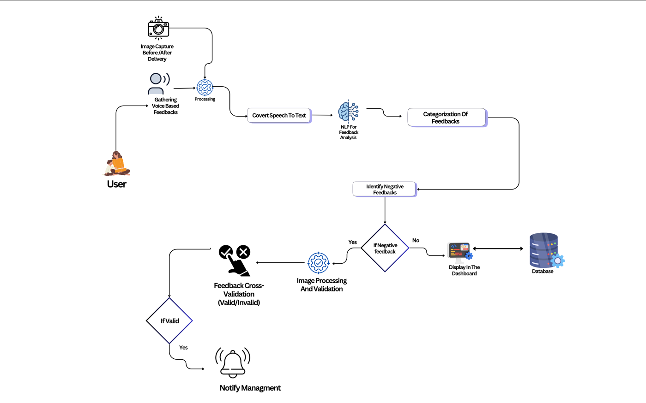
COMPONENT DIAGRAM
IT21374838 | Silva K.H.L.D | 24-25J-298
‹#›
12/5/24
‹#›

Slide 67

COMPLETION AND FUTURE WORKS
Models For Classification and Object Detection
Data Gathering & Train Data Set .
UI Design & Prototype
Component Integration
sssfIntegrate Backend and Fronten
IT21374838 | Silva K.H.L.D | 24-25J-298
‹#›
12/5/24
‹#›

Slide 68


TECHNOLIGIES TO BE USED
Tenser Flow
NLP
Python
Whisper
CNN
Flutter
​
IT21374838 | Silva K.H.L.D | 24-25J-298
‹#›
12/5/24
‹#›

Slide 69
DEMONSTRATION
IT21165948 | D.T.D Dissanayake | 24-25J-298
‹#›
12/5/24
‹#›

Slide 70
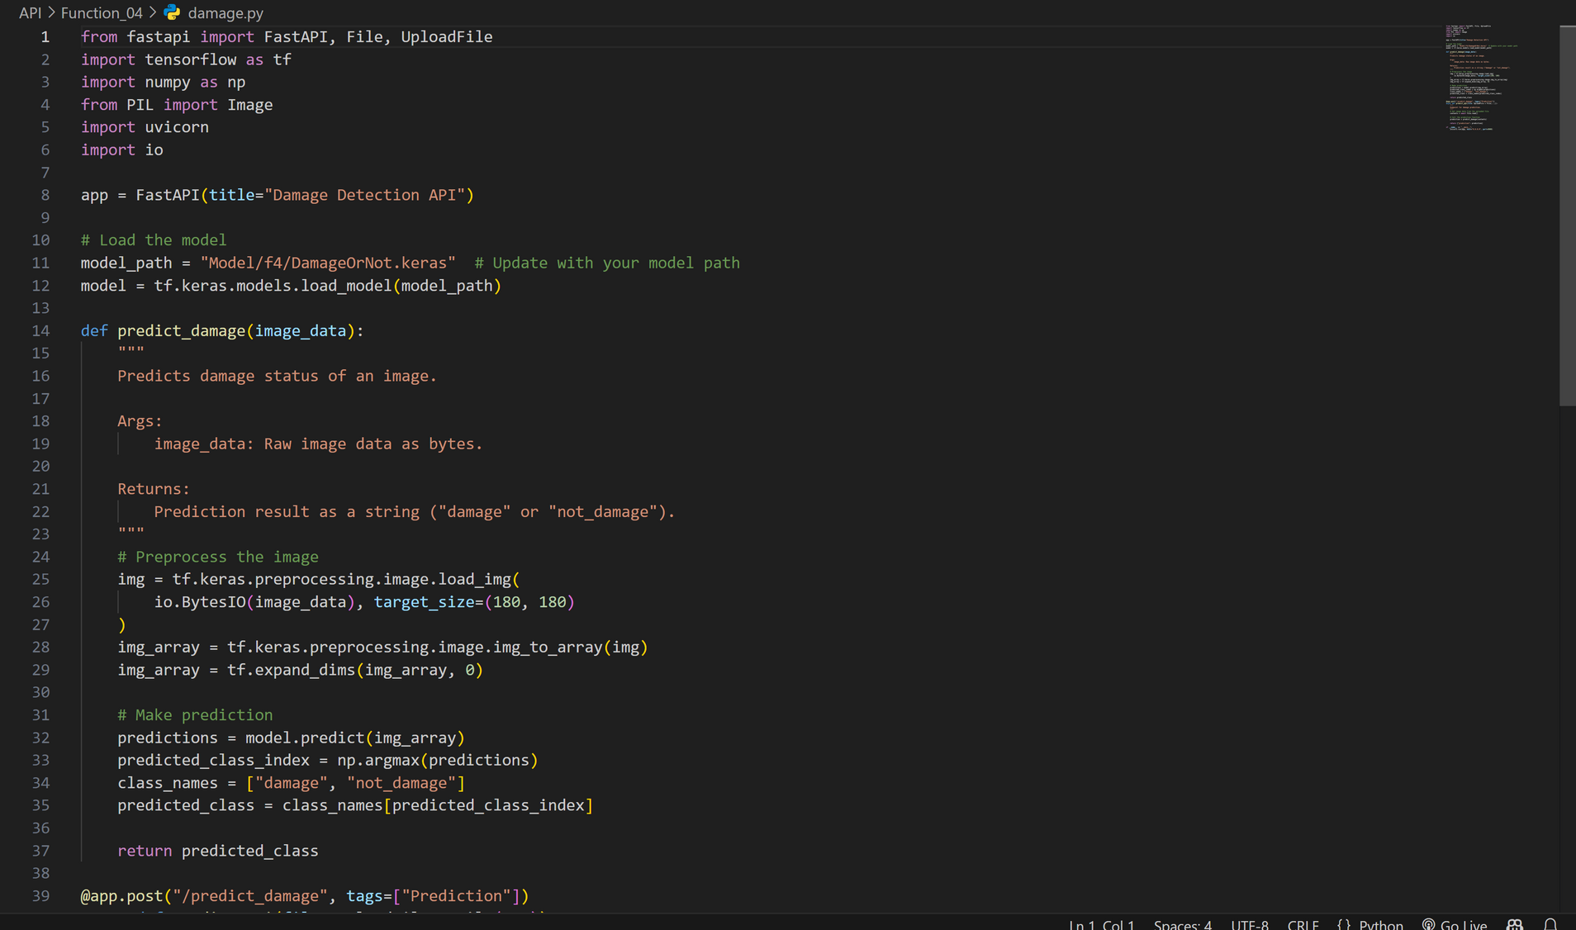
Python Code Data Processing
Damage Predicting Model
IT21374838 | Silva K.H.L.D | 24-25J-298
‹#›
12/5/24
‹#›

Slide 71
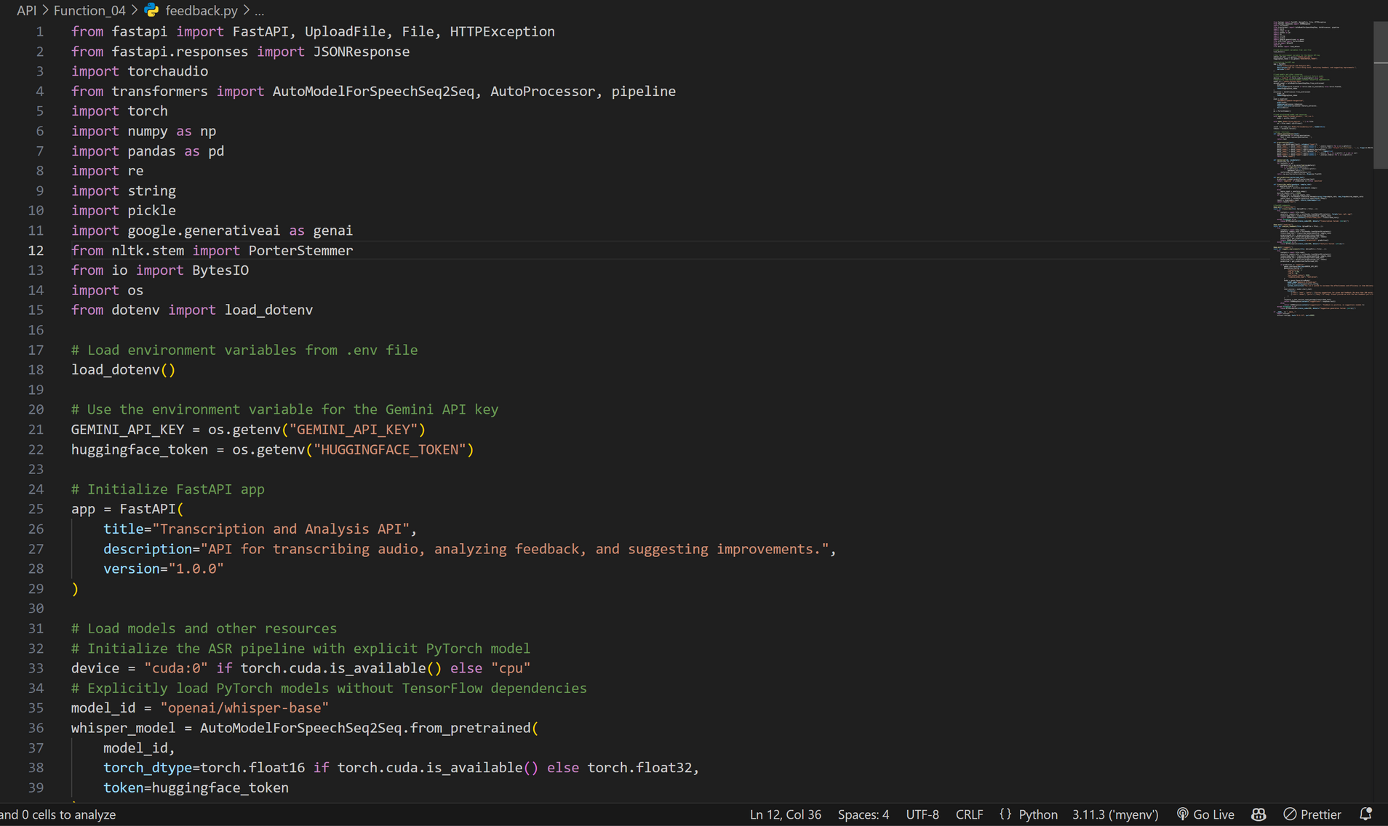
Feedback Analysis Model
IT21374838 | Silva K.H.L.D | 24-25J-298
‹#›
12/5/24
‹#›

Slide 72
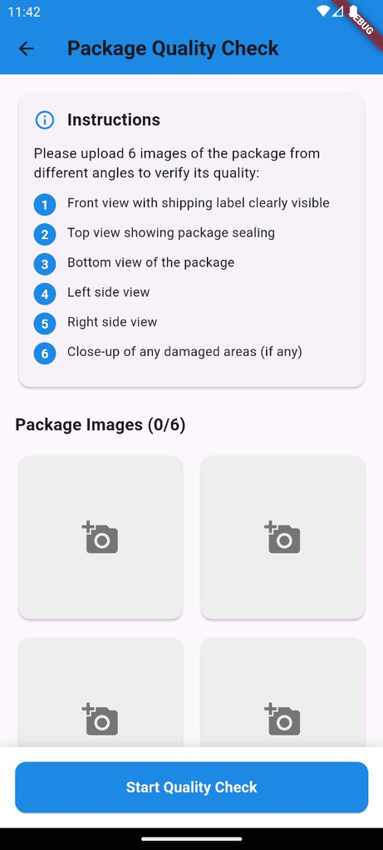
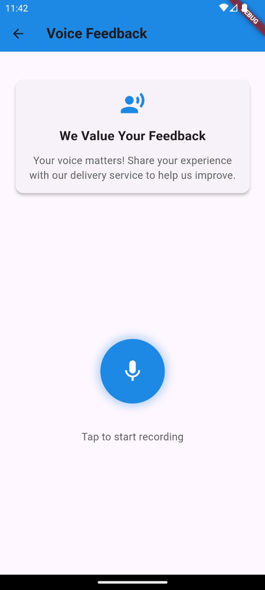
GoSwift Package Validation Checking and Voice Feedback
IT21374838 | Silva K.H.L.D | 24-25J-298
‹#›
12/5/24
‹#›

Slide 73
COMPONENT SPECIFIC REQUIREMENTS
Functional Requirements
NonFunctional Requirements
Feedback Classification
Object Detection
Enhanced Data Filtering
Accuracy and Validation
Speed
Reliability
Validation
Accuracy
IT21374838 | Silva K.H.L.D | 24-25J-298
‹#›
12/5/24
‹#›

Slide 74
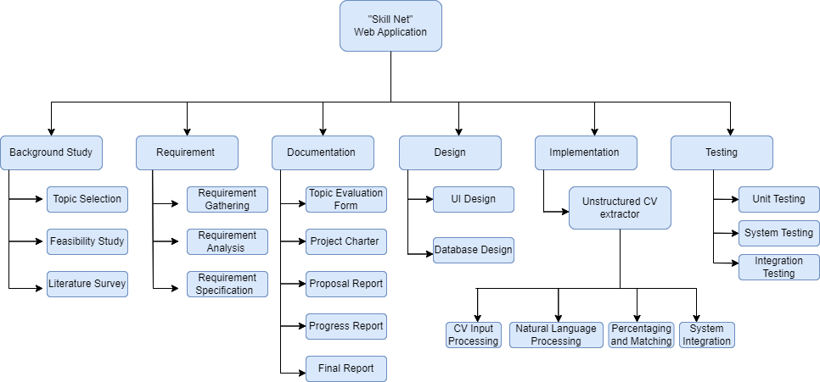
WORK BREAKDOWN CHART
IT21374838 | Silva K.H.L.D | 24-25J-298
‹#›
12/5/24
‹#›

Slide 75
REFERENCES
[1] I. Davydov, "Development of an Intelligent System for Automatic Generation of Individual Study Plans," [Online]. Accessed: Aug. 4, 2024.
[2] M. Gupta, S. Garg, and P. K. Singh, "A Comprehensive Survey on Machine Learning and Deep Learning Based Methods for Automatic Information Extraction from Resumes," IEEE Access, vol. 9, pp. 84119-84136, 2021, doi: 10.1109/ACCESS.2021.3087913.
[3] A. Kumar, R. Pandey, and A. Tripathi, "Efficient Techniques for Extracting Information from Unstructured Resumes," in Proceedings of the International Conference on Computing, Communication, and Intelligent Systems (ICCCIS), Springer, Singapore, 2021, pp. 581-593, doi: 10.1007/978-981-16-2126-0_54.
[4] M. B. Raut, N. S. Marathe, and S. S. Mantha, "Resume Information Extraction and Matching with Job Descriptions Using Machine Learning Techniques," International Journal of Information Technology and Computer Science (IJITCS), vol. 10, no. 9, pp. 22-30, 2018. Accessed: Aug. 4, 2024.
[5] I. P. Rakhlin, "Information Extraction Method from a Resume (CV)," Science Journal, vol. 12, no. 5, pp. 45-52, 2021. Accessed: Aug. 4, 2024.
IT21374838 | Silva K.H.L.D | 24-25J-298
‹#›
12/5/24
‹#›

Slide 76


09. COMMERCIALIZATION ASPECTS
Market Potential
Target educational institutions
Target online course providers
Revenue Model
Subscription-based pricing
Licensing fees
Our app offers budget friendly subscriptions
making quality education accessible to all.
User Segmentation
Schools and institutions
Individual learners
Non-profits and Low-income Users
Free or discounted rates
Marketing Strategy
Promote through educational conferences
Advertise on online platforms
Direct outreach to potential clients
‹#›
12/5/24
‹#›

Slide 77
Thank You
‹#›
12/5/24
‹#›

